Slide 2
I don't trust the news.

Slide 3

The Problem
85% of 18-54-year-olds believe there is a bias
90% of the US population consider the newspapers as biased
In Europe, 60% on average are skeptical about press neutrality

Slide 4
The Problem
85% of 18-54-year-olds believe there is a bias
90% of the US population consider the newspapers as biased
In Europe, 60% on average are skeptical about press neutrality
"You have to check multiple articles for a same topic everyday
It's frustrating."
– Edward, 24

Slide 5
The Source

Slide 6
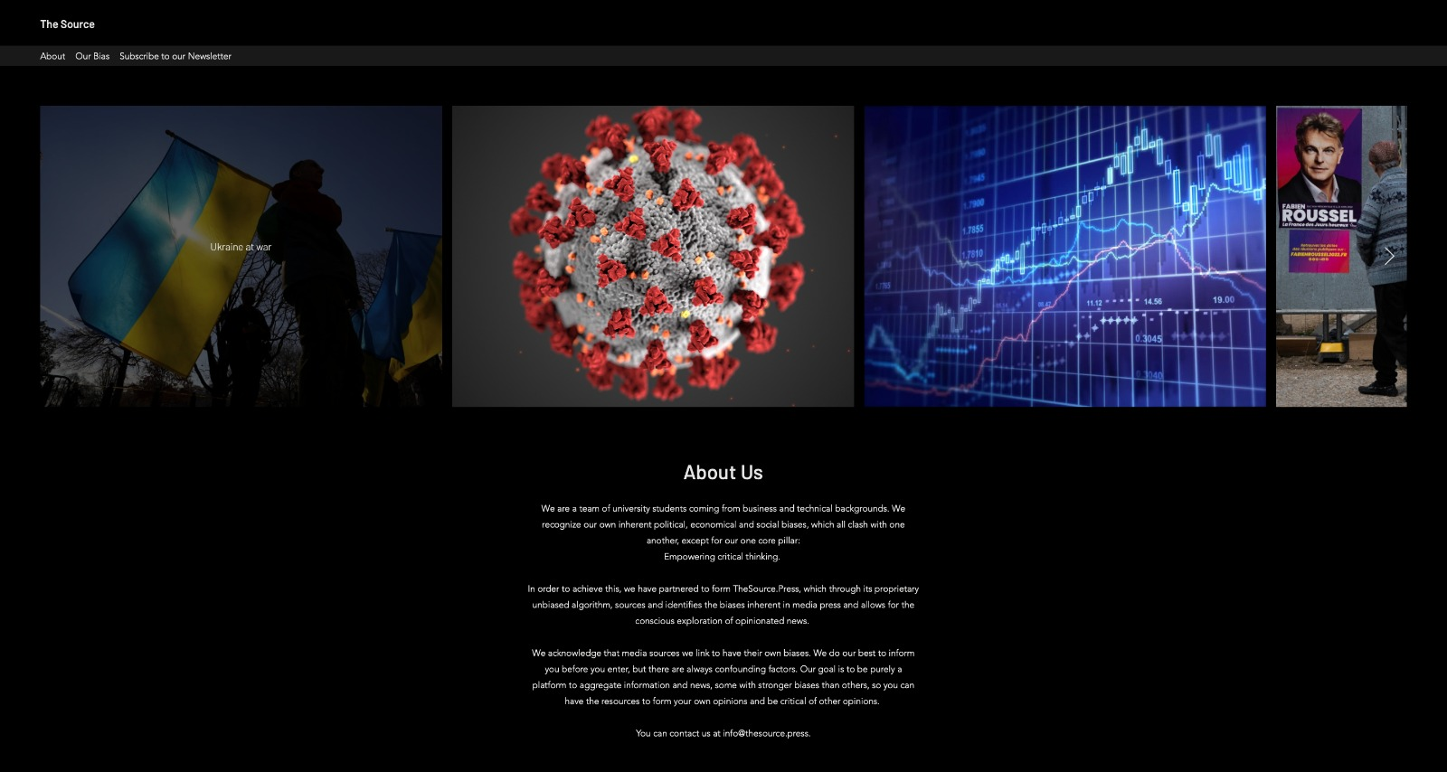

Slide 7
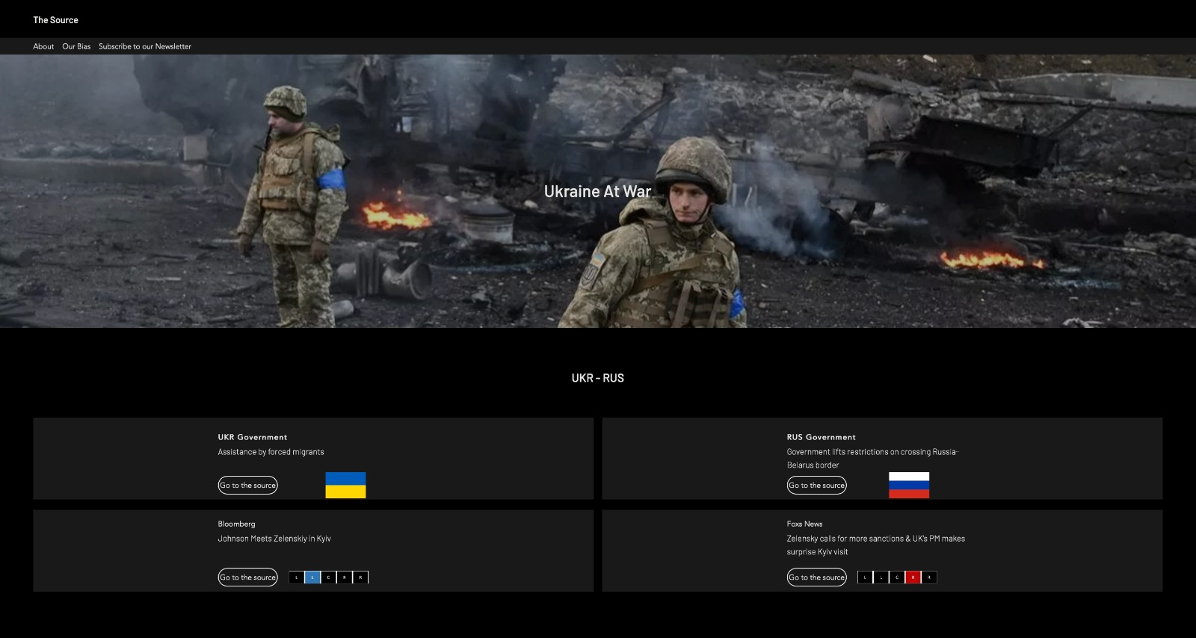

Slide 8
Our solution
The Source
Aggregating & relaying information directly
No intermediary opinions or profit-driven motives
Free

Slide 9
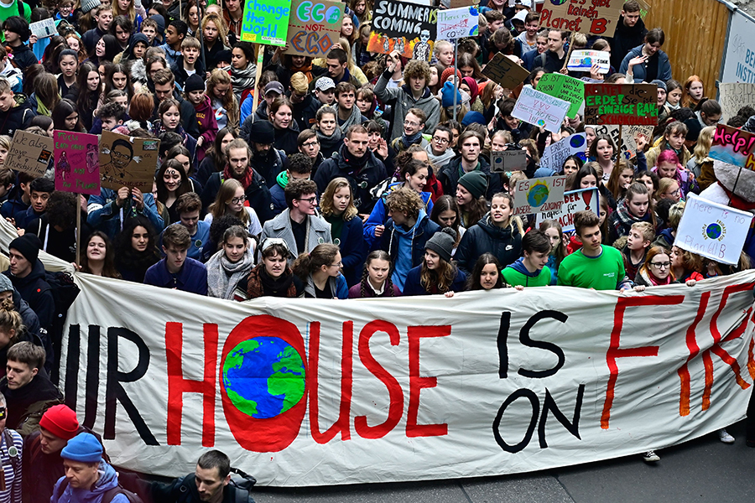
Our solution
Target segment
Early adopters
Total market
18 to 54 year-olds in the US
Millennials

Slide 10
Revenue streams
WEEKLY MEMO
ADVERTISEMENTS
TIPS
$10 / month
50,000 annual visitors
50,000 annual visitors
=
=
50,000 annual visitors
$2,500
$7,500
=
$30,000

Slide 11
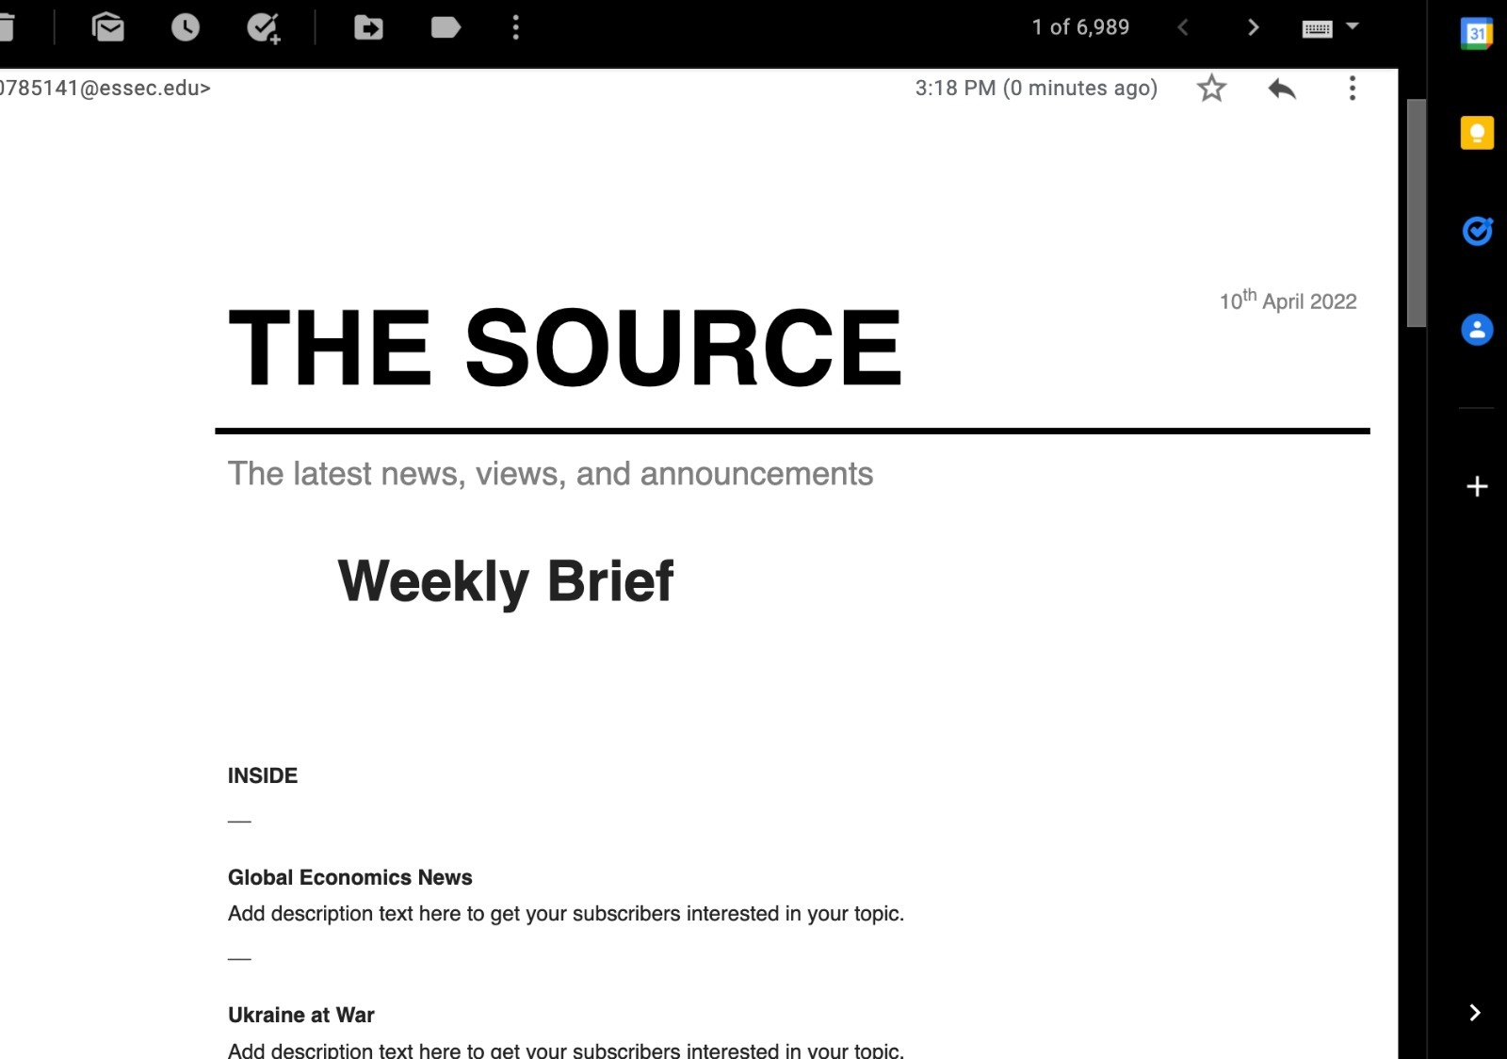
The
Memo

Slide 12

Thank you for your attention !
Visit thesource.press

